Slide 1



Challenges, Opportunities and Solutions for The Retail Banking Industry
APRIL 22nd 2025 | KARACHI
CONCEPT | PANELS | SCHEDULE + GPI PROFILE
AN INITIATIVE OF
SUPPORTED BY

Slide 2
THE CONCEPT
Green Peak International proudly announces ‘The Retail Banking Conference’— a progressive platform where industry trailblazers converge to define the future of banking and finance.
Kickstarting this transformative journey is ‘RETAIL RESET’, our inaugural event set to be held in Karachi on April 22nd 2025. This year’s theme signifies a bold leap toward redefining retail banking for a rapidly evolving landscape. Designed for visionary CEOs, senior executives, and key decision-makers, the conference aims to challenge conventional paradigms and ignite fresh perspectives. Through dynamic discussions, expert insights, and collaborative dialogue, RETAIL RESET will address critical challenges, explore innovative solutions, and highlight emerging trends shaping the industry. It’s an invitation to rethink strategies, embrace disruption, and co-create a future-ready retail banking ecosystem.
This is more than an event; it’s a launchpad for a thought-provoking discussion, where industry leaders and visionaries will redefine what’s possible in the future of banking. This is a gathering no forward-thinking leader can afford to miss.

Slide 3

THE RETAIL LANDSCAPE 20,000 feet view
1
BANK CEO’S & PRESIDENTS
TIMING
9:30- 10:40
KEYNOTE
Atif Bajwa - CEO Bank Alfalah
Challenges and opportunities 2025-2035.
A C-Suite level discussion on how retail banking appears to be shaping out in the next decade, given the transformative digital disruptions and policy changes forecasted.
What will the next year challenge us with, let alone the next 10?
MODERATOR
Syed Faraz Anwer- PwC Pakistan
PANELISTS
Humayun Sajjad - CEO Mashreq Pakistan
Atif Aslam Malik - COO JS Bank
Shazad Dada - Former CEO UBL, SCB, Barclays Bank, Pak
Muhammad Aminuddin – CEO TPL Insurance

Slide 4
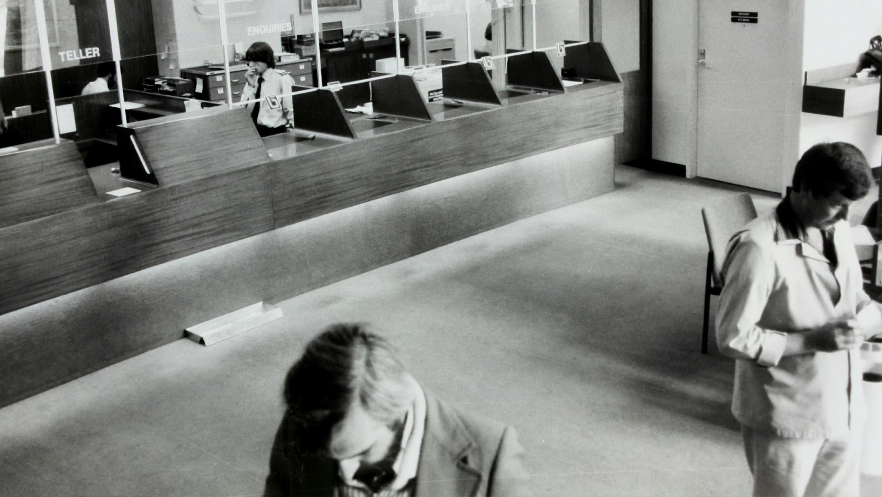
CHALLENGES AND OPPORTUNITIES IN RETAIL BANKING Ground view
2
BANK RETAIL HEADS
TIMING
11:00- 12:20
KEYNOTE
Ariful Islam - Former Deputy CEO Meezan Bank
Designing accurate & timely products, rethinking customer segmentation and how to gain share of wallet.
How to enhance personalization in retail banking, increase product penetration, build brand loyalty and improve retention, while diversifying portfolio mix and structuring customer centric products and services.
How do you grow the business while keeping risks and limitations in mind?
MODERATOR
Salman Sarwar Butt- CEO, Green Peak International
PANELISTS
Mehreen Ahmed - Group Retail Head, Bank Alfalah
Saadya Riaz - MD - Head Wealth & Retail Banking, SCB, Pak
Syed Kazim Raza - Country Head Retail Banking, JS Bank
Ahmed Shah Durrani - Head Retail Banking & CDO, HMB

Slide 5

SELLING WEALTH
REPRESENTATIVES OF AMC'S & INSURANCE COMPANIES, PREMIUM SEGMENT HEADS OF BANKS
3
TIMING
12:25- 1:30
FIRESIDE CHAT WITH
Muhammad Aminuddin - CEO TPL Insurance
A discussion on enhancing bank offerings to wealthy and premium customers through curated wealth products & more.
Innovative products or innovative selling? Are we really designing products for customers or simply for businesses?
Selling Wealth to the wealthy= can we truly act as financial advisors for a broad spectrum of customers?
Insurance has been around for decades- are we going to see any radical changes in the industry going forward?
MODERATOR
Raeda Latif - ED & Country Head CABM, SCB Pak
PANELISTS
Shazia Khurram - Head of Branch & Priority Banking, Meezan Bank
Zaigham Sheriff - Head Wealth & Premier Banking, Bank Alfalah
Zeeshan Quddus - Chief BDO, UBL Fund Managers
Asim Hafeez Qureshi - Head of Product & Analytics, JS Bank
Sarah Irfan - Head Liabilities & Bancassurance, HMB

Slide 6

RETAIL OUTSIDE OF BANKING Discovering wonderland-through the looking glass
4
CEO’S OF E-COMMERCE, FMCG RETAIL BRANDS
TIMING
2:30- 3:30
PRESENTATION
Amir Paracha - CEO Unilever
A dive into the retail world outside of banking. A chance to parley with leaders of retail giants across Pakistan and discovering common grounds. How is that they are delivering ace customer service and customer experience while banks remain challenged?
Justifying real estate vs digital estate.
Customer segmentation
Innovative payment solutions
The Sacred Sales Funnel
Forecast for the virtual customers
MODERATOR
Aurangzeb Siddiqui - TPL Insurance
PANELISTS
Amir Paracha - CEO Unilever
Muntaqa Paracha - CEO, Foodpanda
Sammer Sultan - Co-Chairwoman, Shan Foods
Arif Lakhani - Co Founder, Qistbazaar

Slide 7

ENHANCING CUSTOMER & PERSONNEL EXPERIENCE
5
SQ/ CE HEADS, HR HEADS+ L&D HEADS
TIMING
3:30- 4:30
An in-depth look at market practices regarding customer experience and service quality in banks. How are we creating customer friendly processes and environments?
What are the gaps in the market and customer perception on brand and delivery?
Is customer experience a direct derivative of the quality of human resources serving them?
Measuring customer service- the accuracy and challenges of calculating NPS.
How is optimum workforce planning, talent distribution, and attrition of employees being addressed?
MODERATOR
Mehmood Shamsher Ali - CEO, Alif Innovations
PANELISTS
Khalid Zaman - Head of Human Resources, Meezan Bank
Pouru Sidhwa - HR Head, Easypaisa Digital Bank
Muhammad Ali Jangda - Snr Adv, Banking Ombudsman
Faran Niaz- Director Customer Experience at HALA, Dubai

Slide 8

Redefining Reach: Balancing Branches, Bytes & Business
6
DIGITAL BANK CEO’S & DIGITAL HEADS OF BANKS
Yahya Khan- CDBO, Bank Alfalah
TIMING
4:30- 5:30
PRESENTATION
As digital banking gains ground, Pakistan’s banks must rethink the role of brick-and-mortar branches. This session explores how both models can coexist to drive customer experience, financial inclusion, and efficiency, while tackling the growing need for B2B payment digitization and regulatory readiness.
The future of branches: advisory hubs vs. transaction centers
Scaling digital for underserved and informal segments
Unlocking B2B payments—bringing SMEs into the digital fold
Regulatory enablers: digital onboarding, KYC, and open banking
Designing a hybrid strategy for inclusive, tech-enabled growth
MODERATOR
Mir Nejib Rahman- Advisor Pakistan Banks Association
PANELISTS
Yahya Khan - CDO, Bank Alfalah
Omer Bin Ahsan - CEO, Haball Pvt. Ltd.
Sharjeel Murtaza - CDO, Karandaaz
Nofel Daud - CDO Bank of Punjab
Sohail Javaad - Executive Director, DFSG, SBP
Leila Serhan - GM North Africa, Levant & Pak for VISA

Slide 9
SCHEDULE
SEGMENTS | TIME | FORMAT
Registration/ Networking | 8:30-9:00
Bismillah and Welcome Address | 9:00-9:015
CHIEF GUEST SPEECH Mr. Saleem Ullah Deputy Governor SBP (Tentative) | 9:15-9:30 | SPEECH
 |  |  | PARTICIPANT PROFILE
KEYNOTE (RETAIL BANKING LANDSACPE) | 9:30-9:50 | SPEAKER
1-THE RETAIL BANKING LANDSCAPE | 9:50-10:40 | PANEL DISCUSSION | CEO’S & PRESIDENTS OF BANKS & COOs
TEA BREAK | 10:40-11:00
KEYNOTE (EXECUTING RETAIL GROWTH) | 11:00-11:20 | SPEAKER
2-EXECUTING RETAIL GROWTH Challenges and opportunities in retail banking | 11:20-12:20 | PANEL DISCUSSION | RETAIL HEADS OF BANKING BUSINESS
FIRESIDE CHAT | 12:25-12:45 | DISCUSSION | WEALTH & INSURANCE EXPERT
3-SELLING WEALTH | 12:45-13:30 | PANEL DISCUSSION | PREMIUM SEGMENT HEADS OF BANKS, CEO'S OF AMC'S & INSURANCE COMPANIES, PSX REPRESENTATIVES,
LUNCH BREAK | 13:30-14:30
PRESENTATION | 14:30-14:45 | SPEAKER
4-RETAIL OUTSIDE OF BANKING Discovering wonderland-through the looking glass | 14:45-15:30 | PANEL DISCUSSION | CEO’S OF E-COMMERCE, FMCG RETAIL BRANDS
5- ENHANCING CUSTOMER & PERSONNEL EXPERIENCE | 15:30-16:30 | PANEL DISCUSSION | SQ/ CE HEADS, HR + L&D HEADS
PRESENTATION 6- DIGITAL OR BRICK AND MORTAR How to win the game and co-exist? | 16:30-16:45 16:45-17:30 | SPEAKER PANEL DISCUSSION | DIGITAL BANK CEO’S & DIGITAL HEADS OF BANKS
CLOSING REMARKS (PBA & GPI) | 17:30-17:45 | SPEAKERS
TEA & NETWORKING | 18:00 onwards

Slide 10
WHAT TO EXPECT
RIVETING DISCUSSIONS: This gathering of the banking industry's brightest minds will act as a dynamic think tank, encouraging open dialogue to identify challenges, uncover opportunities, and foster innovative solutions. INSIGHTS INTO TRANSFORMATIVE TRENDS: Stay ahead of the curve by discovering groundbreaking innovations and emerging products poised to reshape the industry, helping you adapt and thrive in a rapidly evolving landscape.
POST CONFERENCE TAKE AWAY NOTES: Attendees will receive key takeaway notes along with a comprehensive report summarizing the main discussion points and topics covered, delivered directly to your inbox. MEET PEERS AND SOLUTION PROVIDERS: The conference will bring together the most influential representatives from across Pakistan’s banking industry, providing a unique platform to exchange ideas, share experiences, and build lasting connections.

Slide 11

who we are
At GPI, we specialize in delivering transformative solutions that empower businesses to thrive in an ever-changing world. With a reputation built on trust, innovation, and impact, we bring unmatched expertise and a deep understanding of local market nuances to every engagement. Our team, a diverse collective of seasoned professionals from a range of industries, is united by a shared commitment to delivering bespoke solutions tailored to your unique needs.
Over the years, our interventions have empowered countless clients to achieve notable outcomes. Whether it's crafting tailored strategies, equipping teams with cutting-edge skills, or delivering actionable insights, GPI’s ethos revolves around collaboration, excellence, and innovation.
When you work with GPI, you gain more than just a consultant—you gain a trusted ally committed to your success, delivering excellence at every step.

Slide 12
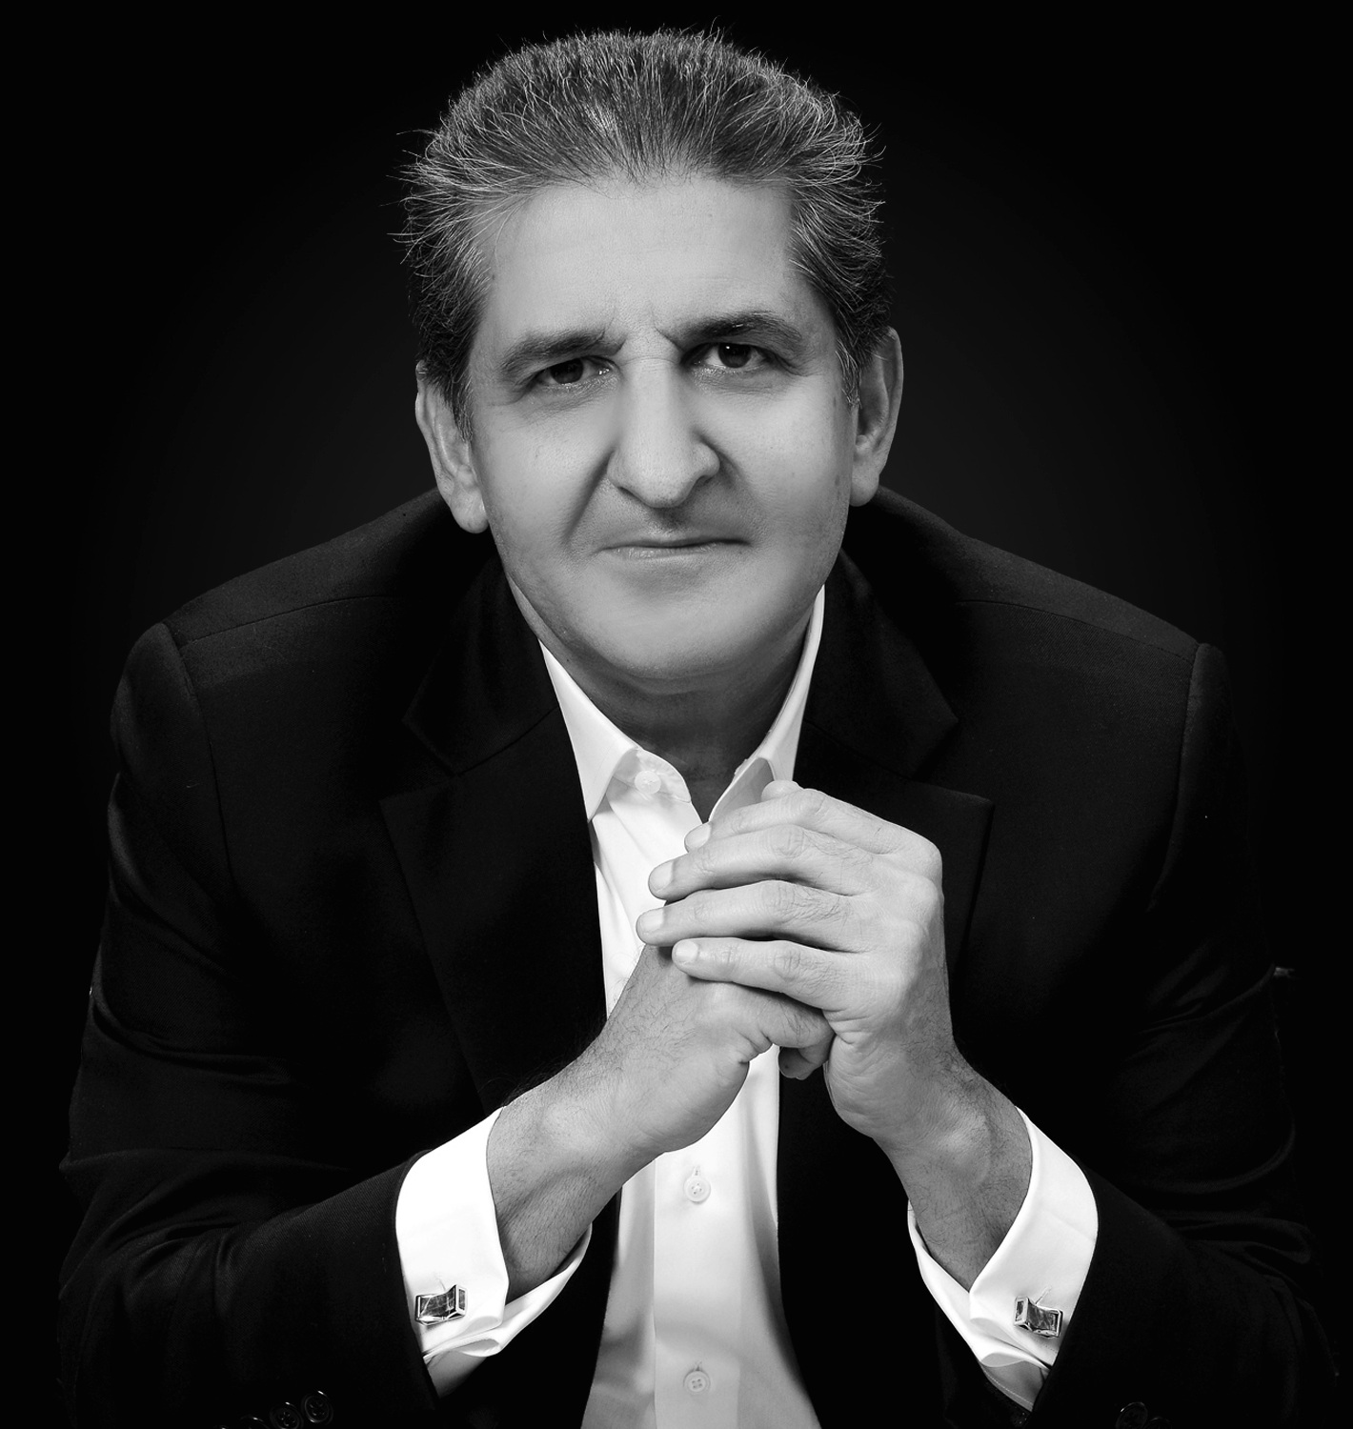
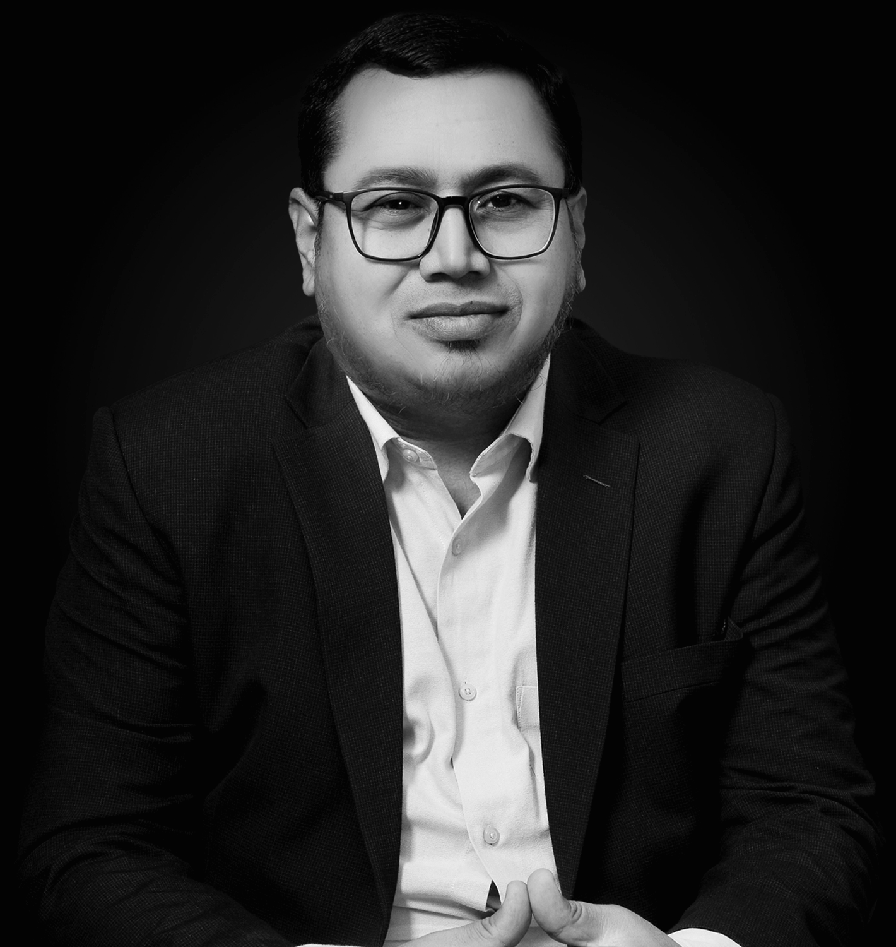
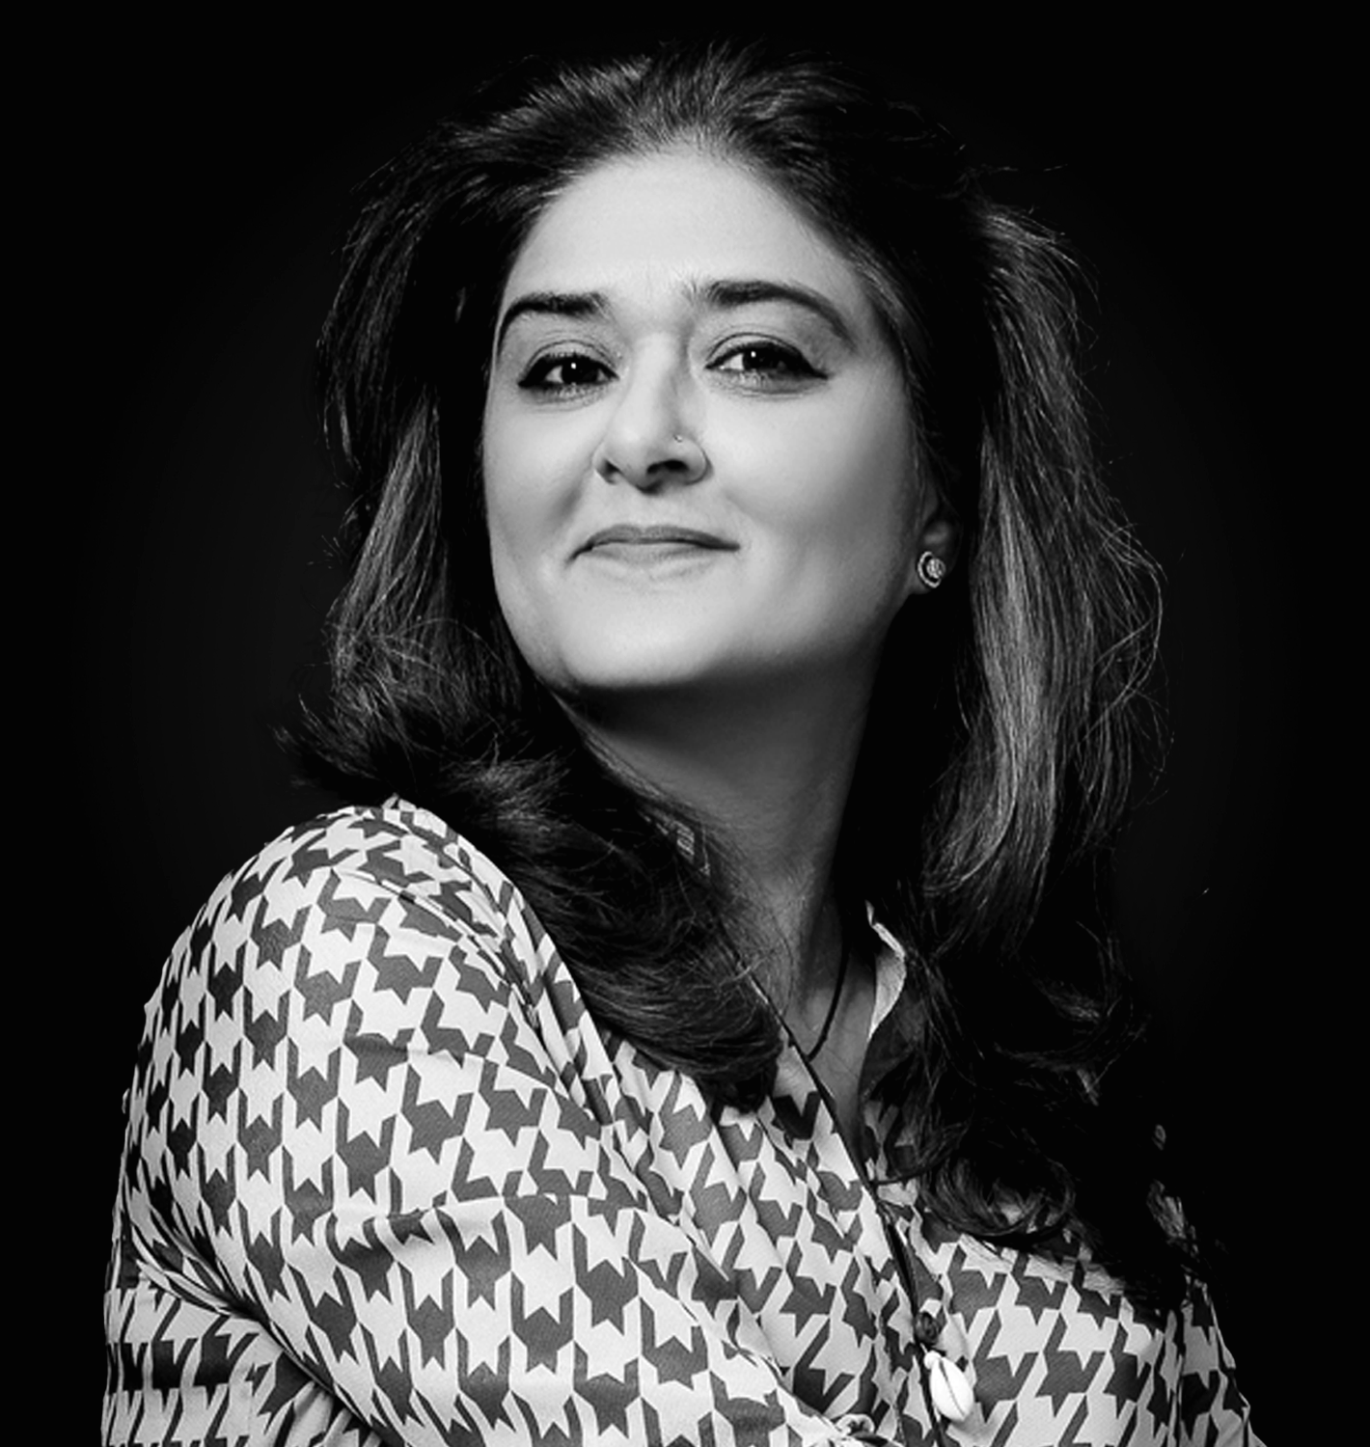
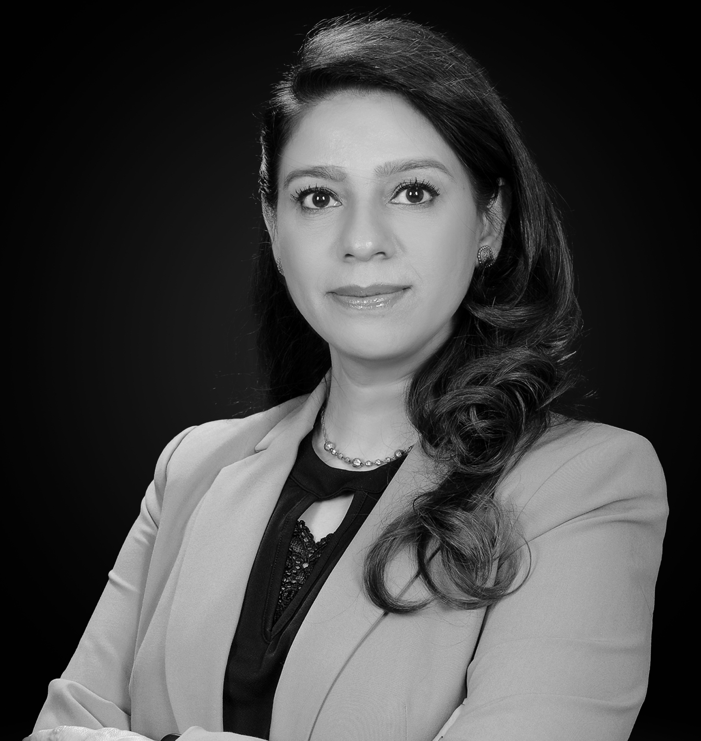
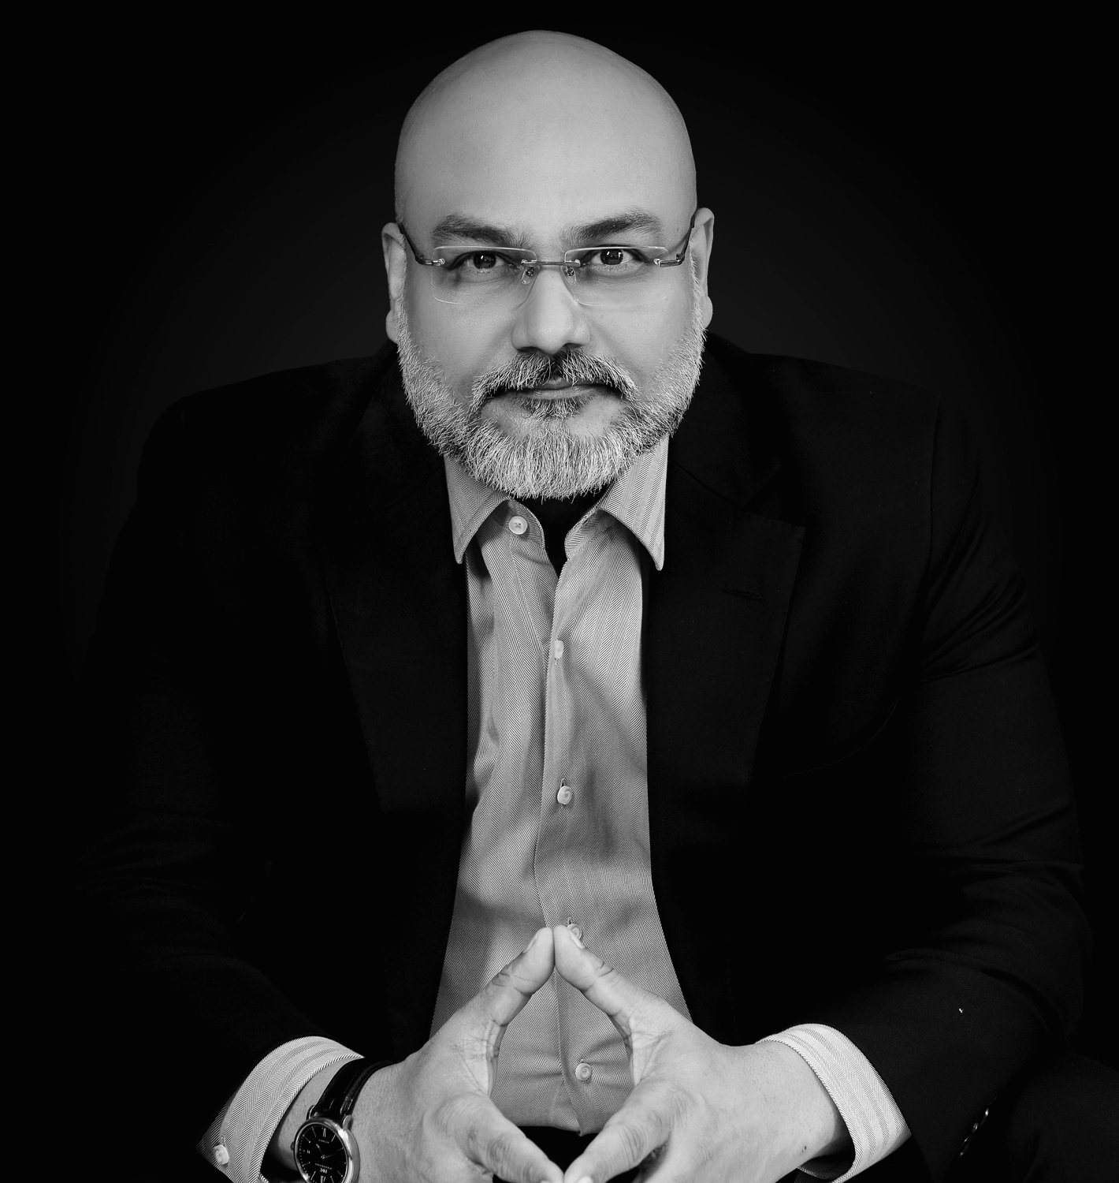
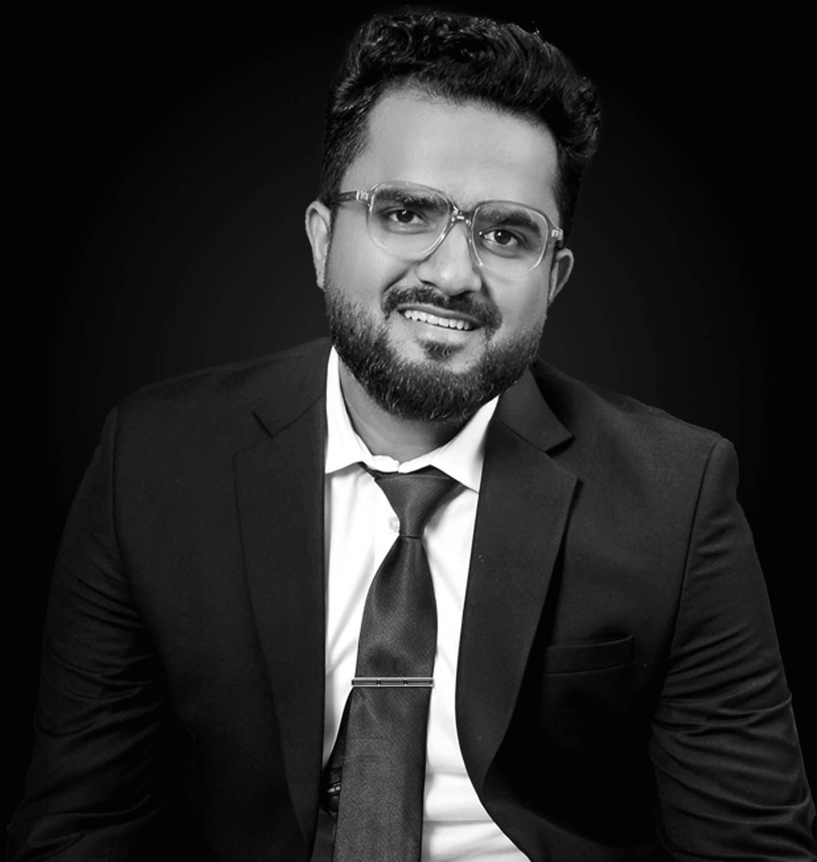
our team
SALMAN SARWAR BUTT Salman is the CEO of Green Peak International. He brings with him 30 years of experience in Retail & Consumer Banking. He has served as Group Head in Pakistan and Asia Pacific. Prior to joining GPI, he held senior positions at ABN AMRO, RBS, NIB and Citibank. AISHA KHAN Aisha specializes in strategic planning and brand language; with over two decades of experience in design, marketing, management and communication. She excels in leading teams to achieve exceptional results, prioritizing user-centric approaches for seamless experiences. FAISAL SHEHZAD ABBASI Faisal holds 27 years+ working experience in diversified worlds of Reg-tech, Wealth-tech, Health-tech, Insurtech, Banking and Advisory. He is a turn-around specialist with a proven track record of launching first-time initiatives coupled with improved customer journeys, distribution channel optimization and improved cost efficiencies. |  | HASSAN TARIQ Hassan is the Director of Outsourcing at Green Peak International. He has over 20 years of experience in HR Operations and Outsourcing and has worked with several reputable organizations including Faysal Bank, RBS, ABN AMRO and HRS Global. SHABNAM MINHAS Shabnam brings with her 25+ years of work experience in International Trade & Advisory, Business Banking and Customer Service, Retail Banking, Corporate Service and Banking Operations with banks like ABN Amro, RBS, Faysal Bank, Habib Bank and Citi Bank. She founded VisionHer and is serving as an Independent director on few boards. AMANULLAH MEHAR Amanullah Mehar, is a dedicated HR professional certified in Human Resource Management. His proficiency in Human Resource and Payroll operations is a driving force behind Green Peak International's optimized and innovative HR practices.

Slide 13





















our clients

Slide 14
Retail Reset is a Green Peak International event supported by the Pakistan Banks Association
www.gpi.org.pk
info@gpi.org.pk | conferences@gpi.org.pk
+92 21-35247108 | +923018887108

